Slide 1

Welcome to Year 3 parent meeting
Mission statement – Together we grow, achieve and thrive
Notes:
Lindsey

Slide 2
Mental Health Support Team
Notes:
Lindsey

Slide 3
Welcome to the
Mental Health Support
Team!

Slide 4

Introduction
We’re based in your child’s school. We help support the school and pupils with their mental health. You might see us doing assemblies, group work and offering events where we speak to teachers and parents.
We offer 1-1 short term support to children and parents which includes 6-8 weeks of low intensity support for moderate to mild mental health needs.
Your child can be referred to our service via school, the GP or self-referral.

Slide 5




We ALL have mental health
Mental Health affects our...
Feelings
Emotions
Thinking
Behaviour
Notes:
Mental Health affects our Emotions, Feelings, Thinking and Mood.
We all have mental Health just like we all have physical health
Mental Health is just as important as our physical health so we should understand it and look after it in the same way

Slide 6

What are some of the mental health challenges we work with?
Low mood
Anxiety (generalised and separation)
Sleep challenges
Managing worry
These are just some of the areas we specialise - consider discussing your child’s need with the mental health lead to review appropriate support

Slide 7
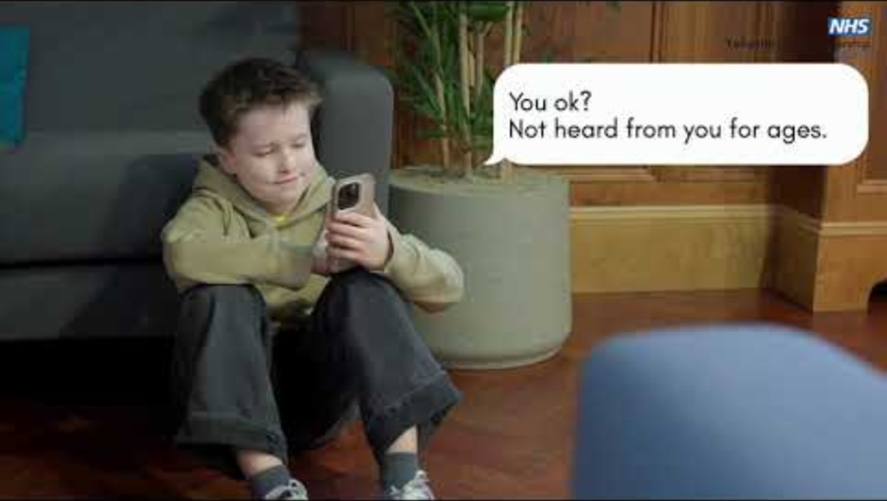

Slide 8
How can I get support from the Mental Health Support Team?
Speak to your child’s teacher and they can consider referring you to the Mental Health Support Team.
You can also be referred via your GP or alternatively, you can self-refer.

Slide 9
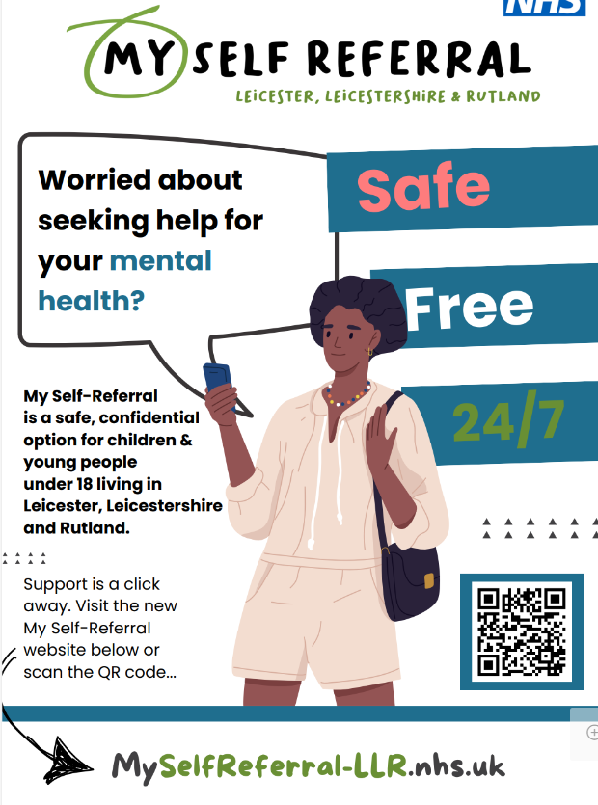

Slide 10

Questions

Slide 11
How can I help my child in Year 3?
Notes:
Lindsey

Slide 12
Staff in Year 3
Teachers
Miss Ward
Mrs Knapton
Miss Watts
Mrs Rigby
Miss Tarjanyi
Teaching Assistants
Mrs Sohansoha
Ms Kava
Mrs Mayes
Notes:
Introduce ourselves

Slide 13

Things to remember
Doors open at 8:40am
Doors close at 8:50am
Breaktime 10:35am
Lunchtime 12:10
End of school day 3:10pm. If late please ring the school office
Names on clothes
Water bottle
Reading folder or a bag
Milk scheme in school - please speak to Office
Breaktime - healthy snack can be brought in from home
Notes:
Natasha

Slide 14




Behaviour
Good to be green
Wolsey WarehouseTokens for displaying good behaviour, producing work to the best of their ability, displaying our school values and for having 100% attendance each school week
Golden time is a reward for those children who respect and follow our school rules.
Notes:
Lindsey

Slide 15
Core values
Everyone strives to live by our 6 core values:
Responsibility
Respect
Honesty
Resilience
Aspiration
Cooperation

Slide 16
What changes in Year 3?
Moving in to the KS2 building
Cloakrooms being separate from the classrooms
Playing on the big playground
Starting new subjects like French
Greater independence in completing tasks

Slide 17
Expectations in Year 3 – Children
Wear school uniform
PE kit on PE day
Good attitude towards learning
Listen to all adults
Follow core values and class rules
Attend school every day and on time
Show resilience when things are challenging
Take responsibility for their own equipment
Notes:
Gayathri

Slide 18
Expectations in Year 3 - Parents
Let us know if you will be late/medical appointment
Daily attendance on time for school
Support your child with reading and homework
Let the office or class teacher know if a different adult will be picking your child up
Notes:
Michelle

Slide 19
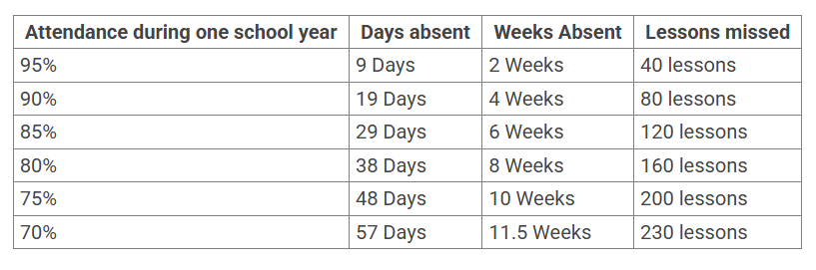
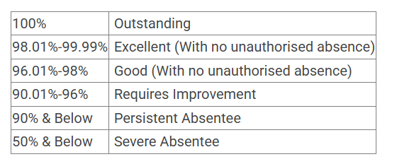
Attendance
In school everyday and on time
If absent please report the absence to the office
before the start of the school day on each day of absence
Wolsey Warehouse at the end of each half term
Half termly hamper draw
5 mins late poster
Notes:
Lindsey

Slide 20

Mental health:
Ensuring our children, their families and our staff have good
mental health is one of our highest priorities as a school.
Children have a daily mental health check-in using a personalised lollipop person
If ever you, or your child, needs support in this area, please speak to your child’s class teacher, our SEND CO Mrs Cooper-Marsh or Mrs Green, who is our Wellbeing Lead.
Notes:
Michelle

Slide 21
Reading
Daily reading at home aim for 20 minutes
Read a variety of things, reading book,
magazine, comic, recipes and discussing what you have read together.
Reading book to be in school everyday
Notes:
Lindsey

Slide 22
Writing
Encourage children to write at home
shopping lists, thank you notes, diaries
Spaces between words
Handwriting – begin to join handwriting
I am a Year 3 pupil at Wolsey House Primary School
Notes:
Gayathri

Slide 23
Maths
Know number bonds to 10
Place value to 100
Learning multiplication tables fluently
Weekly times table challenge test
Notes:
Natasha

Slide 24
Our aim for Year 3
We aim to support children in becoming:
Happy
Independent
Resilient
Curious
Confident learners
Notes:
Natasha

Slide 25


Information
Website class page
Weduc
Notes:
Michelle

Slide 26
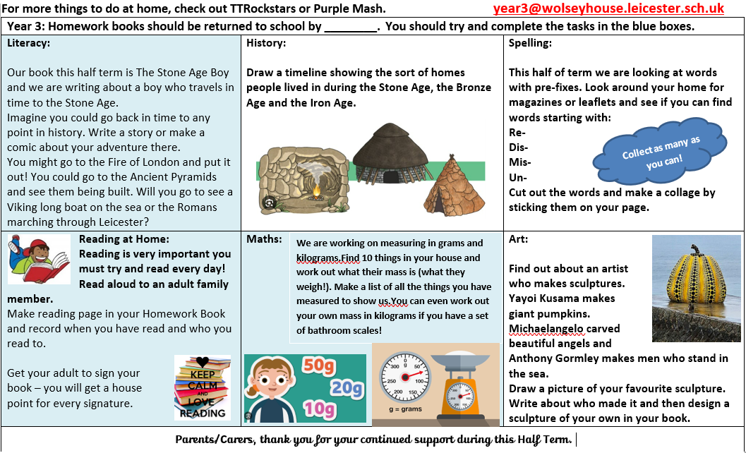
Homework
Example homework grid
Notes:
Lindsey

Slide 27
Any questions
Notes:
Lindsey

