Slide 1

Welcome to Year 1 parent meeting
Mission statement – Together we grow, achieve and thrive
Notes:
Bridgette

Slide 2
Mental Health Support Team
Notes:
Caroline

Slide 3
Welcome to the
Mental Health Support
Team!

Slide 4

Introduction
We’re based in your child’s school. We help support the school and pupils with their mental health. You might see us doing assemblies, group work and offering events where we speak to teachers and parents.
We offer 1-1 short term support to children and parents which includes 6-8 weeks of low intensity support for moderate to mild mental health needs.
Your child can be referred to our service via school, the GP or self-referral.

Slide 5




We ALL have mental health
Mental Health affects our...
Feelings
Emotions
Thinking
Behaviour
Notes:
Mental Health affects our Emotions, Feelings, Thinking and Mood.
We all have mental Health just like we all have physical health
Mental Health is just as important as our physical health so we should understand it and look after it in the same way

Slide 6

What are some of the mental health challenges we work with?
Low mood
Anxiety (generalised and separation)
Sleep challenges
Managing worry
These are just some of the areas we specialise - consider discussing your child’s need with the mental health lead to review appropriate support

Slide 7
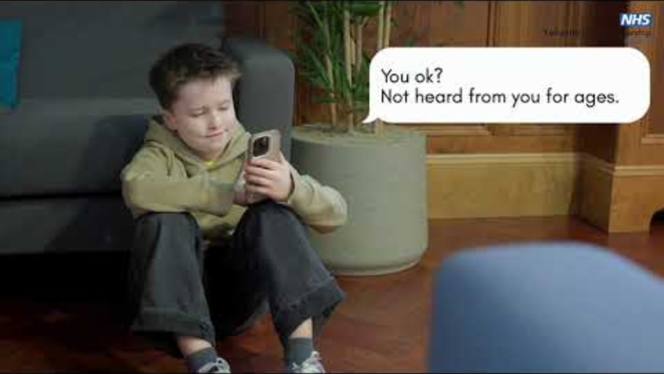

Slide 8
How can I get support from the Mental Health Support Team?
Speak to your child’s teacher and they can consider referring you to the Mental Health Support Team.
You can also be referred via your GP or alternatively, you can self-refer.

Slide 9
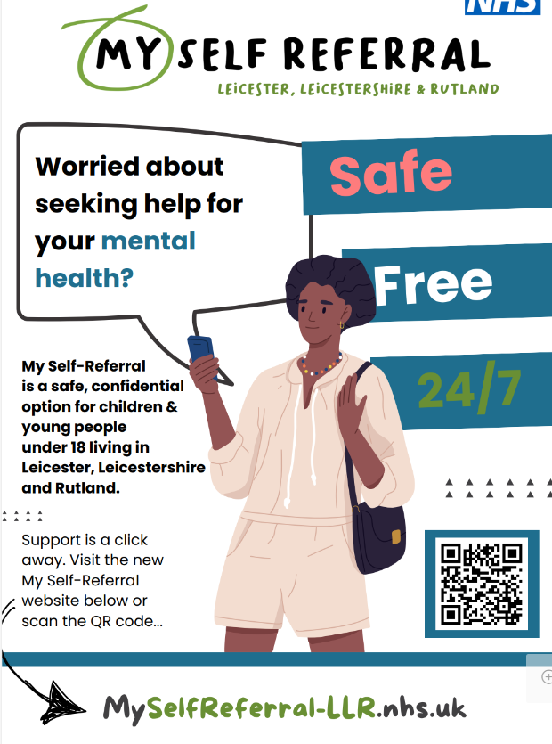

Slide 10

Questions

Slide 11
How can I help my child in Year 1?

Slide 12



Staff in Year 1
Teachers
Mrs Collins
Miss Worrall
Miss Barden
Teaching assistants
Mrs Harrison
Mrs Rao
Mrs Borg
Miss Mudey
Notes:
Introduce ourselves

Slide 13
Things to remember
Doors open at 8.45am
Doors close at 8.55am
Breaktime 10.15
Lunchtime 11.45
End of school day 3.15. If late please tell the school office
Names on clothes
Water bottle
Reading folder or a bag
Milk scheme in school please speak to office
Breaktime healthy snack provided by school
Notes:
Emily

Slide 14




Behaviour
Good to be green
Wolsey WarehouseTokens for displaying good behaviour, producing work to the best of their ability, displaying our school values and for having 100% attendance each school week
Golden time is a reward for those children who respect and follow our school rules.
Notes:
Courtney

Slide 15
Core values
Everyone strives to live by our 6 core values:
Responsibility
Respect
Honesty
Resilience
Aspiration
Cooperation
Notes:
Bridgette

Slide 16
Expectations in Year 1 – Children
Wear school uniform
PE kit on PE day – No crocs
Good attitude towards learning
Listen to all adults
Follow core values and class rules
Attend school every day and on time
Notes:
Emily

Slide 17
Expectations in Year 1 - Parents
Let us know if you will be late/medical appointment
Daily attendance on time for school
Support your child with reading and homework
Birthday sweets to be vegetarian
Notes:
Courtney

Slide 18

Expectations in Year 1 - staff
Communicate effectively verbally and through Weduc
Deliver a varied and stimulating curriculum
Adapt the curriculum for your child’s needs where
necessary
Notes:
Bridgette

Slide 19
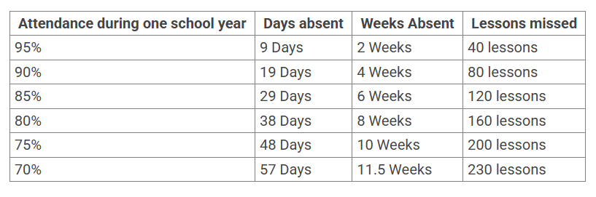
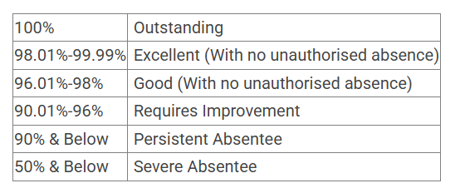
Attendance
In school everyday and on time
If absent please report the absence to the office
before the start of the school day on each day of absence
Wolsey Warehouse at the end of each half term
Half termly hamper draw
5 mins late poster
Notes:
Emily

Slide 20

Mental health:
Ensuring our children, their families and our staff have good
mental health is one of our highest priorities as a school.
Children have a daily mental health check-in using a personalised lollipop person
If ever you, or your child, needs support in this area, please speak to your child’s class teacher, our SEND CO Mrs Cooper-Marsh or Mrs Green, who is our Wellbeing Lead.
Notes:
Courtney

Slide 21
Assessment
Termly assessments
Phonics screening in June
Notes:
Bridgette

Slide 22
Reading
daily reading at home aim for 10 minutes
Read a variety of things, reading book,
magazine, comic, recipes
Reading book to be in school everyday
Lost reading books will be charged
Notes:
Emily

Slide 23
Writing
Encourage them to write at home
shopping lists, thank you notes, diaries
Spaces between words
Practise weekly spellings together,
Focusing on phonics – sounding words out
and breaking them up
Handwriting – forming their letters
correctly, letters sitting on the line
Notes:
Courtney

Slide 24
Maths
Knowing numbers to 100.
Addition and subtraction
Number bonds to 20
Multiplication 2,5,10s
Fractions ½ and ¼
2D and 3D shapes
Measure – length, height, mass, volume and capacity
Time
Money
Number formation
Place value
Notes:
Bridgette

Slide 25


Information
Website class page
Weduc
Notes:
Emily

Slide 26
Special events in year 1
Family days
Church visit at Christmas
Sports day
Charity events
Class chicks – Spring term
Local walks
Notes:
Courtney

Slide 27
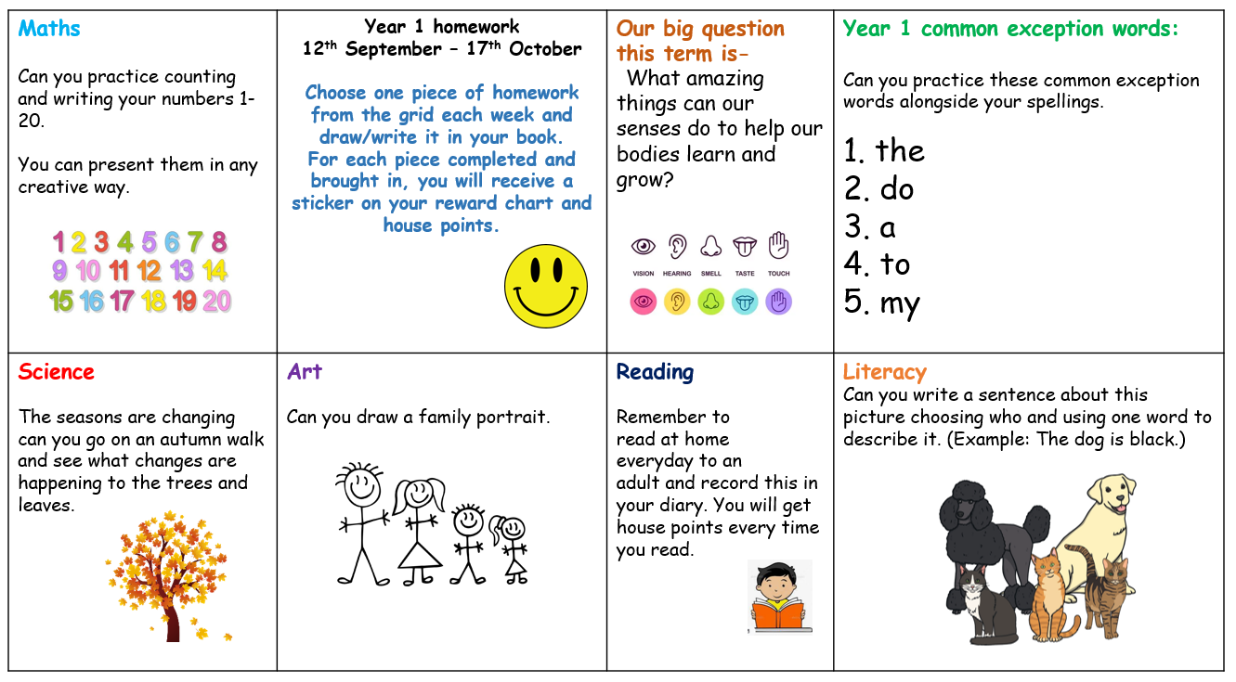
Example homework grid
Weekly spellings given
Notes:
Bridgette

Slide 28
Things to do over the summer holiday with your child
Cooking
Shopping lists
Tying shoe laces (Velcro shoes)
Dressing themselves
Doing up zips on coats and buttons
Play I spy
Cutting with scissors and sticking
Notes:
Emily

Slide 29
Any questions
Notes:
Courtney

