Slide 1




Wolsey House Primary School
Year 3
Autumn 1

Slide 2
Welcome Parents!
Welcome to our Year 3 page.
Here, you will find the following information:
  Our core values
  Staff who work in Year 3
  The Year 3 school day
  Our P.E days
  Special days
  WEDUC
  Attendance
  School uniform
  Behaviour
  Ways you can help your child at home
  Childline

Slide 3

Our Core Values
Creating a school where everyone is safe, happy and healthy and where everyone strives to live by our 6 core values:
  Responsibility.
  Respect.
  Honesty.
  Resilience.
  Aspiration.
  Cooperation.

Slide 4
Staff who work in Year 3
Teachers
Class 1 – Miss Ward (Monday, Tuesday and Wednesday) and Mrs Rigby (Wednesday, Thursday and Friday)
Class 2 – Mrs Knapton
Class 3 – Mrs Tarjanyi (Monday, Tuesday and Wednesday) and Miss Watts (Thursday and Friday)
Teaching Assistants
Mrs Sohansoha
Ms Kava
Mrs Omar
Mr Bellfield
Mrs Khodiyar

Slide 5
The Year 3 school day
8:40am – children line up on playground and class teacher brings them into class.
10:35am – break time
12:10pm – lunch time
3:10pm – home time

Slide 6
Year 3 P.E days
Tuesday –
Thursday – Yoga

Slide 7
Special days

Slide 8

Weduc
We use ReachMoreParents (also known as Weduc) as our main communication platform between school and home. This website and app are where we share all key information with parents and carers, including announcements, updates about school events and important reminders.
By using ReachMoreParents, we ensure that parents receive timely and accurate information straight from the school in a secure and convenient way.
Through ReachMoreParents, parents can also easily access details about school activities, such as trips, clubs and special events. The platform allows us to send messages directly to each family so parents never miss out on important updates. It’s much more efficient and environmentally friendly than sending paper letters home and it means that communication is consistently up to date. It also allows parents and carers to report a child’s absence.
Another vital feature of ReachMoreParents is its parents’ evening booking system. Parents are able to view available time slots and book appointments with teachers directly through the app or website. This gives families flexibility to choose times that suit them and helps the school organise these events smoothly.
Overall, ReachMoreParents plays a crucial role in strengthening the partnership between school and home. It helps parents stay informed, engaged, and involved in their child’s education. By centralising communication and making it easy for parents to access key information and services, ReachMoreParents supports a positive and connected school community.

Slide 9
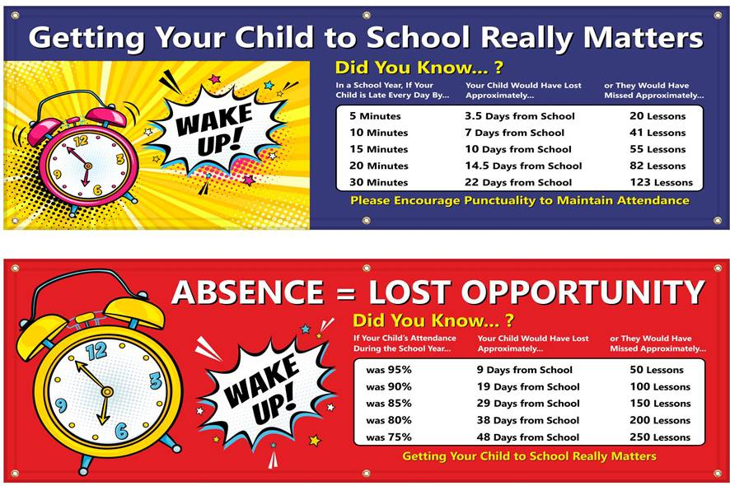

Attendance

Slide 10



School Uniform
Jewellery
Stud earrings only. No necklaces or bracelets
Earrings will need to be taken out or covered with a plaster whilst doing PE
Uniform items with the school logo can be purchased from https://myclothing.com
There is no requirement for children to wear uniform with the school’s logo on, but there is an expectation that the children wear school colours, i.e. red or black jumper. These can be bought from a range of shops e.g. Asda, Tesco.
Book Bags and PE Bags printed with the school logo can be purchased on the Parent Pay app and collected from the school office
PE Kit
Your child will need to come into school dressed in their PE kit on their PE day
Indoor: Red or white t-shirt, black shorts and plimsoles
Outdoor: Jogging bottoms, zip up jacket or sweatshirt and trainers. No hoodies
For the whole school
Red or black jumper, cardigan or fleece. No hoodies
Grey or black trousers, skirt or pinafore dress
In the summer months a red and white gingham dress may be worn
Nursery, Reception, Years 1 and Year 2
Red or white polo shirt or white shirt or blouse
Years 3, 4, 5 and 6
White or Black polo shirt or white shirt or blouse
Suitable footwear must be worn. No Crocs
Indoor
Outdoor

Slide 11

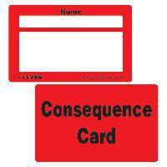


Behaviour
IT’S GOOD TO BE GREEN
We use the Good to be Green behaviour reward system. In each class from Years 1 to 6 there is a Good to be Green wall chart. Every child has a green card, showing that they are “Good to be Green”. At the start of every day, every child will be green. During the day, children who follow the school and class rules stay on a green card.
However, children who make the wrong choices and don’t follow the rules will be given a yellow warning card. If they continue to make the wrong choices, they will be given a red Consequence card. In this instance, staff will carry out some restorative work with the child in an attempt to ensure that there won't be any repeated behaviour.
Wolsey Warehouse tokens
Warehouse tokens are awarded to a child for displaying good behaviour, producing work to the best of their ability, displaying our school values and for having 100% attendance each school week . Each child is allocated a container, which acts as a wallet. Tickets are cumulative and, on the Friday, at the end of each half-term, all children enjoy visiting the Wolsey Warehouse with their class teacher to choose a reward.

Slide 12
Ways you can help your child at home
Homework should be completed weekly.
Times Tables Rockstars helps children to practise quick mental recall of times tables facts.
Daily reading helps your child to become a fluent and confident reader. Asking your child questions based on their reading book also improves comprehension skills.
Accelerated Reader quizzes assess how much your child has read and understood.

Slide 13

Childline has launched a website aimed at children under the age of 12. This provides age appropriate content on topics including: bullying, family, friends, feelings, school, abuse and staying safe. It also includes games and therapeutic tools for young visitors to play and express how they are feeling.
It can be accessed here: https://www.childline.org.uk/kids

