Slide 1
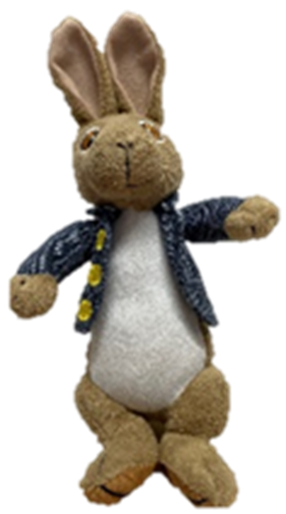
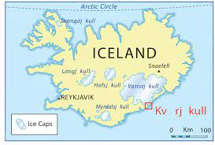
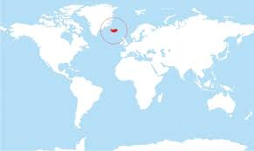
I am in Iceland.
Iceland is in the Artic ocean.

Slide 2
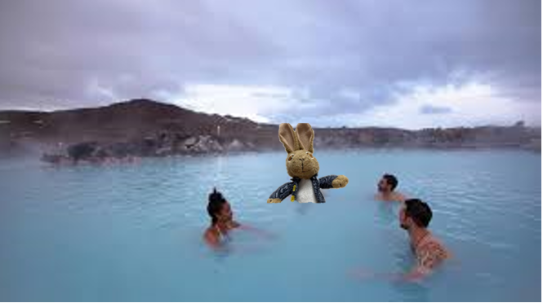
Here I am in the Blue Lagoon. Even though it is really cold in Iceland, the temperature of the water is 38 degrees, which feels like a warm bath. The people are really kind and they are teaching me to speak Icelandic. The word for hot tub in Icelandic is Heitur pottur.

Slide 3
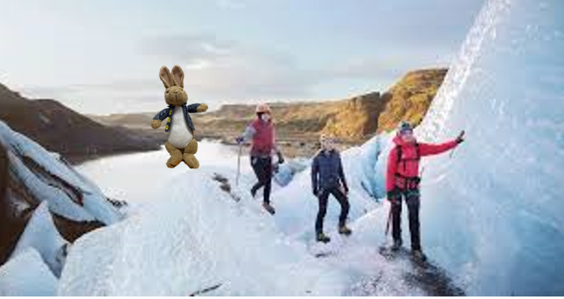
There are lots of mountains in Iceland and here I am climbing the tallest mountain in Iceland called
the crown of Hvannadalshnúkur
It is covered in snow all of the time. It is 6050 feet tall and it was a little bit scary.

Slide 4
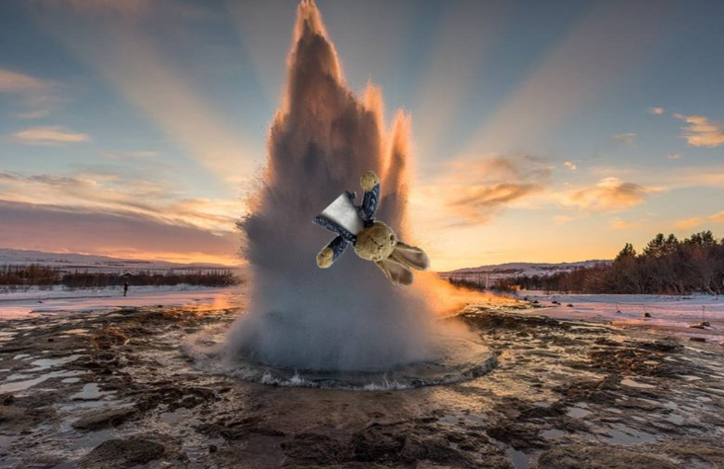
This is a famous geyser called Stokkur. I think I got a little bit to close. “Geysir” is
the Icelandic word for gush, which is what a geyser is, it is a gush of hot water
that shoots up out of the ground. There is a you tube clip of it on the internet. Why not
have a look?
https://www.youtube.com/watch?v=98Pkkjr6q4

Slide 5
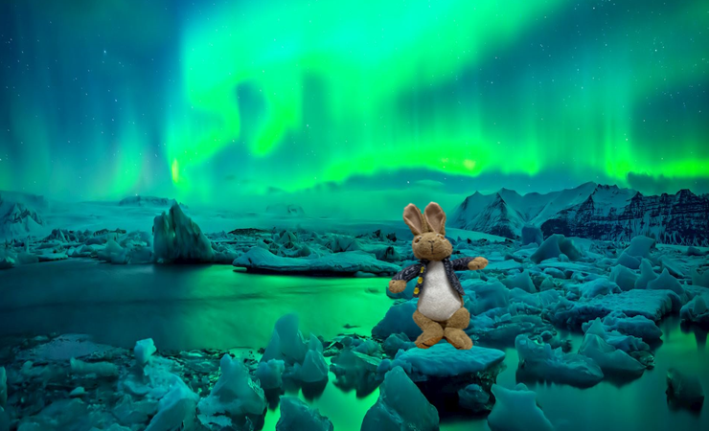
I am so lucky to be here in Iceland in January because I get to see the Northern lights. This amazing light show can be seen when it is dark and there are no clouds. Did you know that between May 21st and July 30th the sun does not go down, which means that it doesn’t every get dark? How confusing , how would you know when to go to sleep?

Slide 6
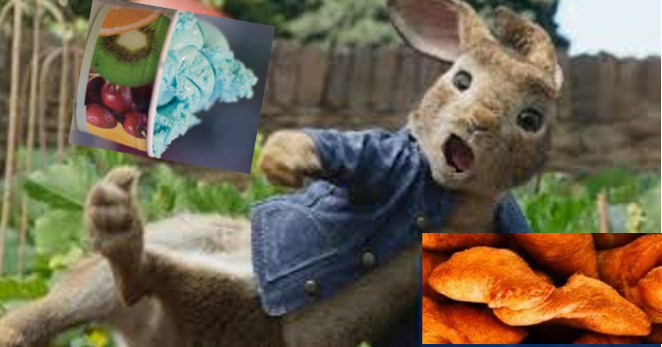
This is me trying traditional Icelandic food. Blue ice- cream and Kleinir, which are similar to doughnuts.

Slide 7
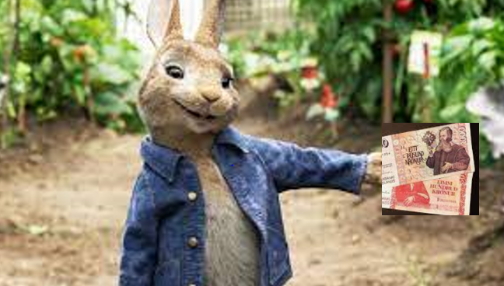
I tried to buy some carrots with a pound coin but you
can not use pound coins in Iceland. The money in Iceland is called
Icelandic Krona

Slide 8
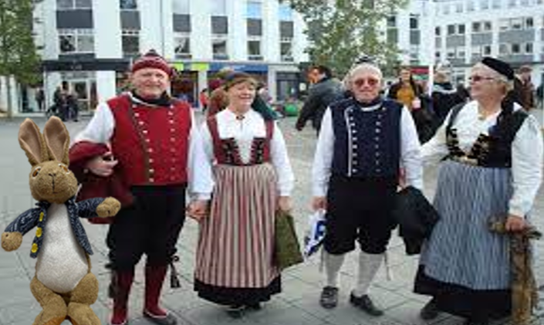
I have met some Icelandic people. They wear the most amazing clothes.
woolen breeches or trousers, a usually double buttoned vest and a double buttoned jacket called treyja. The women wear the faldbúningur with tail-caps. I even got to try some traditional clothes myself.

Slide 9


