Slide 1
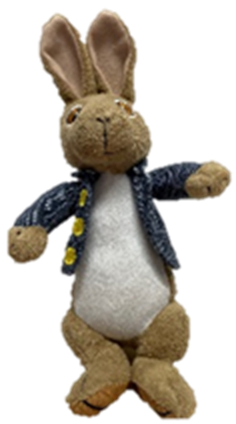
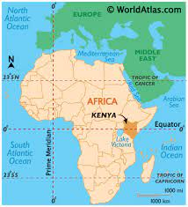
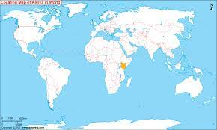
I am in Kenya.
Kenya is in Africa.

Slide 2
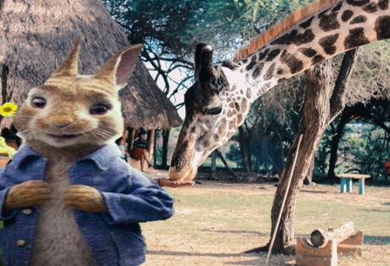
Here I am in the nature reserve. It is amazing and I saw an actual giraffe walking past me whilst
I was out for my morning walk. Did you know that giraffes have black tongues that feel really rough when they lick you?

Slide 3
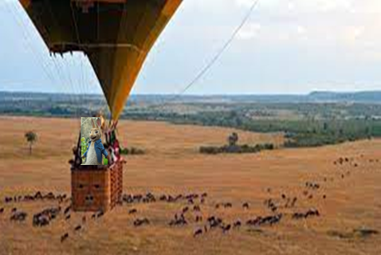
I was able to go in a hot air balloon and see the wonderful country.
The land goes on for miles and miles. It is very hot in Kenya and doesn’t rain very much, which means the land is really dry. The heat makes you very sweaty.

Slide 4
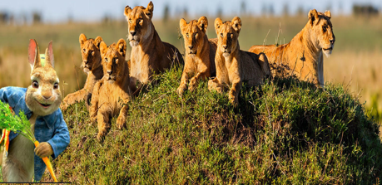
I was out digging for some carrots when I saw a pride of lions just sitting still
staring at me. I think they liked my carrots because they started licking their lips when they saw me with my carrots.

Slide 5
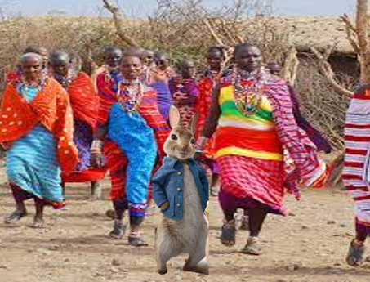
Today I met some lovely Kenyan people and they taught me to dance. The people here speak
Swahili.

Slide 6
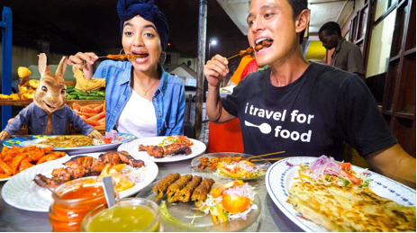
This is me trying some traditional food. They eat ugali, which is made of maize and looks like dough. They also eat nyama choma and this is roasted meat.

Slide 7
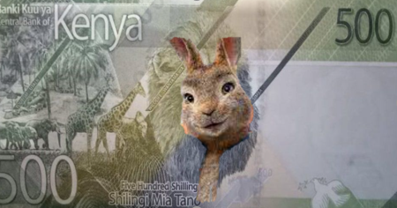
I tried to buy some food with the Icelandic Krona but you
can not use them in Kenya. The money in Kenya is called
Shillings

Slide 8
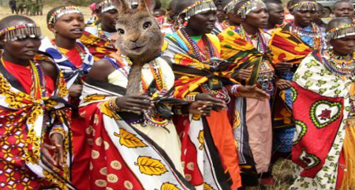
Among traditional Kenyan pieces of clothing is "kitenge". It is a cotton fabric heavily embroidered and colored by the method called tie-and-dye (when the fabric is clothed into a tight bundle, and then dyed with various colors). Kitenge is very colorful and bright, so it is popular not only in Kenya but in many other African countries.
I tried on a khanga. It is a piece of cloth. Its pattern consists of different sayings printed on the fabric. These sayings are in Swahili. Women in Kenya wear khanga around the stomach and waist.

Slide 9
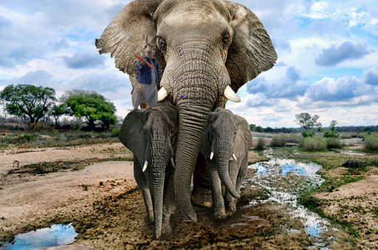
I have made some lovely friends and I am going to miss them.

