Slide 1
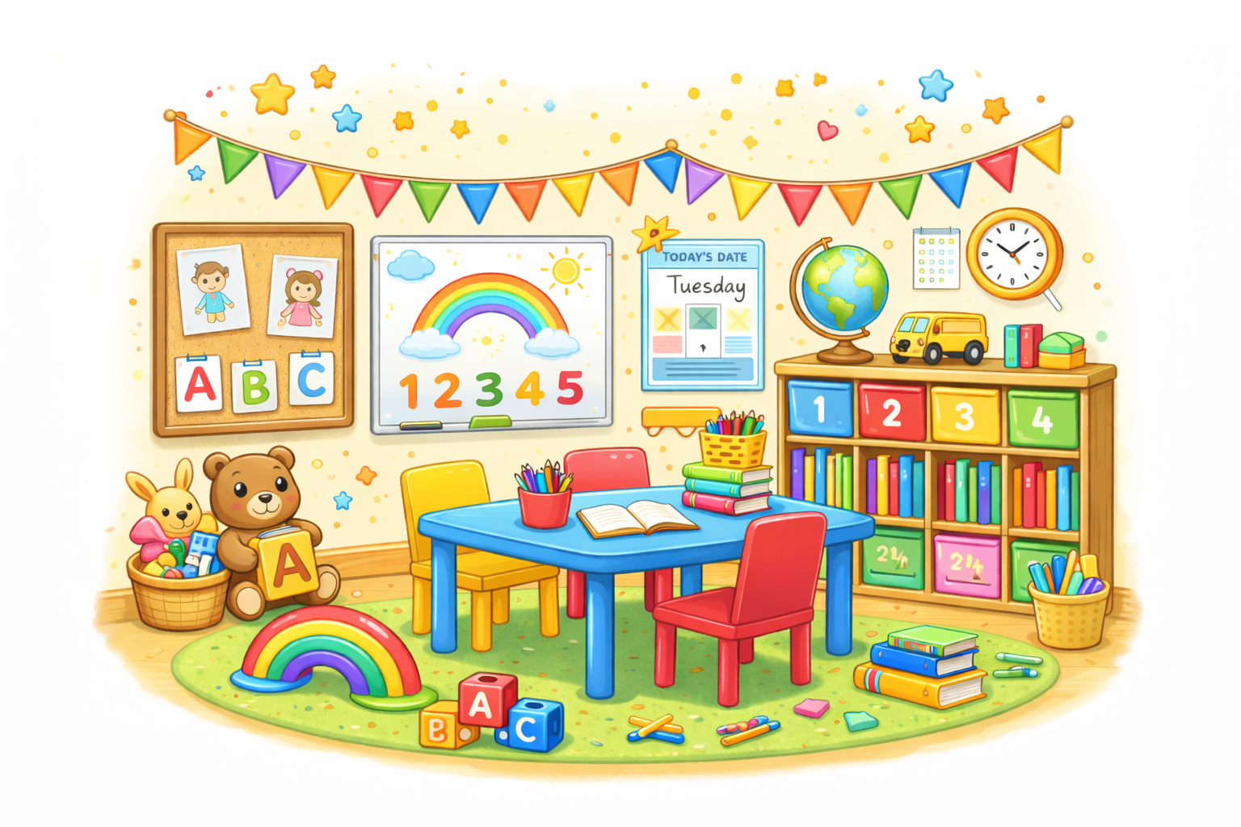
Wolsey House Primary School
EYFS
Summer 2

Slide 2

Welcome Parents!
Welcome to our EYFS page.
Here, you will find the following information:
  Our core values
  Staff who work in the EYFS
  Timings for the day
  Our P.E days
  Special days
  WEDUC
  Attendance
  School uniform
  Behaviour
  Ways you can help your child at home
  Childline

Slide 3

Our Core Values
Creating a school where everyone is safe, happy and healthy and where everyone strives to live by our 6 core values:
  Responsibility.
  Respect.
  Honesty.
  Resilience.
  Aspiration.
  Cooperation.

Slide 4
Staff who work in the EYFS
Teachers in the EYFS
The Robins – Mrs Bunn
The Kingfishers – Mrs Wells (EYFS Leader and Assistant Headteacher)
The Owls – Miss Williams
The Woodpeckers – Miss Stokes
Teaching Assistants in the EYFS
Mrs Lavingia Mrs Peatfield Mrs Omar
Mrs Cooke Mr Mohammed Mrs Wyatt
Mrs Chawda Mrs Brooker Mrs Sago

Slide 5
EYFS Daily Times
Daily times for Nursery:
Morning Session - Starts at 8.45am and ends at 11.45am
Afternoon Session - Starts at 12.15pm and ends at 3.15pm
Full Time Session – Starts at 8.45am and ends at 3.15pm
Daily times for Reception
The day starts at 8.55am and ends at 3.15pm
Lunch session: 11.50am-1.00pm

Slide 6

EYFS P.E days
PE lessons for Nursery and Reception take place every Thursday.
Nursery children will need a pair of plimsolls, preferably in a drawstring bag.
We ask that Reception children wear their PE kit to school on their designated PE day.
Our PE uniform consists of a white or red t-shirt, black shorts and plimsolls. For the winter months children can wear a black tracksuit.

Slide 7

EYFS Library
Library day is on Monday for Reception and Nursery.
The class doors open at 11:30 am / 3:00pm for Nursery and 3.00pm for Reception.
This time allows you to come in and choose a book with your child.
The children may borrow a book to take home and share with an adult.
Children who are ready to and enjoy books from an early age are most likely to become fluent and successful readers themselves in the future.

Slide 8
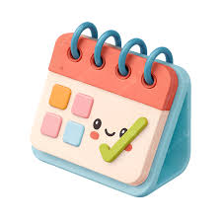
Special days in the Summer Term
Tuesday 2nd June – Reception Sports Day and Family Picnic
Thursday 4th June – Nursery Sports Day and Family Picnic
Monday 8th June – Meeting for New Nursery Parents and Carers – 5.30pm
Thursday 11th June – Meeting for New Nursery Reception and Carers – 5.30pm
Monday 15th June – EYFS Colour Dash Run
Thursday 25th June – Information Evening – Preparing your child for Year 1 – 5.30pm
Final families days – TBC

Slide 9

Tapestry
At Wolsey House Primary School, we use a “Secure Online Learning Journey” called Tapestry.
Tapestry enables staff to add photographs, videos and observations of your child’s learning journey.
You can view your child’s learning journey at anytime.
You can also add your own photographs, videos and observations of things your child does at home and out of school.

Slide 10

Weduc
We use ReachMoreParents (also known as Weduc) as our main communication platform between school and home. This website and app are where we share all key information with parents and carers, including announcements, updates about school events and important reminders.
By using ReachMoreParents, we ensure that parents receive timely and accurate information straight from the school in a secure and convenient way.
Through ReachMoreParents, parents can also easily access details about school activities, such as trips, clubs and special events. The platform allows us to send messages directly to each family so parents never miss out on important updates. It’s much more efficient and environmentally friendly than sending paper letters home and it means that communication is consistently up to date. It also allows parents and carers to report a child’s absence.
Another vital feature of ReachMoreParents is its parents’ evening booking system. Parents are able to view available time slots and book appointments with teachers directly through the app or website. This gives families flexibility to choose times that suit them and helps the school organise these events smoothly.
Overall, ReachMoreParents plays a crucial role in strengthening the partnership between school and home. It helps parents stay informed, engaged, and involved in their child’s education. By centralising communication and making it easy for parents to access key information and services, ReachMoreParents supports a positive and connected school community.

Slide 11
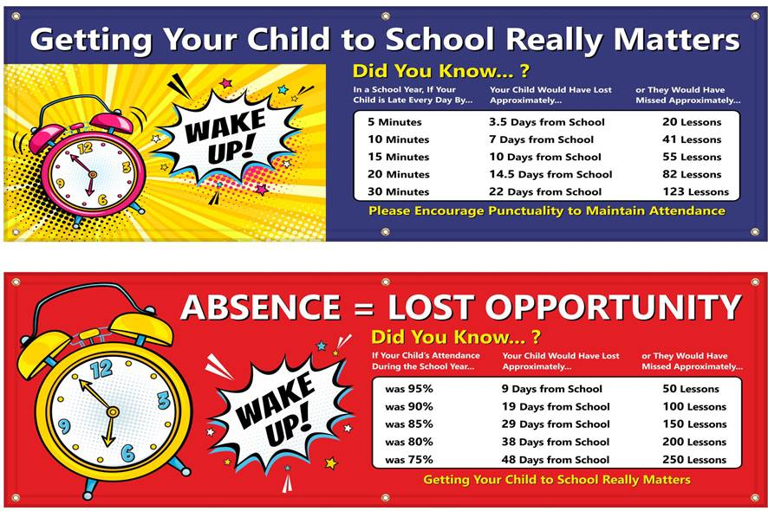

Attendance

Slide 12



School Uniform
Jewellery
Stud earrings only. No necklaces or bracelets
Earrings will need to be taken out or covered with a plaster whilst doing PE
Uniform items with the school logo can be purchased from https://myclothing.com
There is no requirement for children to wear uniform with the school’s logo on, but there is an expectation that the children wear school colours, i.e. red or black jumper. These can be bought from a range of shops e.g. Asda, Tesco.
Book Bags and PE Bags printed with the school logo can be purchased on the Parent Pay app and collected from the school office
PE Kit
Your child will need to come into school dressed in their PE kit on their PE day
Indoor: Red or white t-shirt, black shorts and plimsoles
Outdoor: Jogging bottoms, zip up jacket or sweatshirt and trainers. No hoodies
For the whole school
Red or black jumper, cardigan or fleece. No hoodies
Grey or black trousers, skirt or pinafore dress
In the summer months a red and white gingham dress may be worn
Nursery, Reception, Years 1 and Year 2
Red or white polo shirt or white shirt or blouse
Indoor
Outdoor

Slide 13

Behaviour
Wolsey Warehouse tokens
Warehouse tokens are awarded to a child for displaying good behaviour, producing work to the best of their ability, displaying our school values and for having 100% attendance each school week . Each child is allocated a container, which acts as a wallet. Tickets are cumulative and, on the Friday, at the end of each half-term, all children enjoy visiting the Wolsey Warehouse with their class teacher to choose a reward.

Slide 14
Ways you can help your child at home
Here are some ways which you can support your child’s learning and development at home;
Communication & Language
Talk together about your day.
Ask open questions like “Why do you think…?”
Read stories daily and discuss the pictures.
Sing nursery rhymes and action songs.
Personal, Social & Emotional Development
Encourage turn-taking in games.
Talk about feelings and how to manage them.
Give small responsibilities (tidying toys, setting the table).
Praise effort, not just achievement.
Physical Development
Practise using scissors safely.
Play outside — running, jumping, balancing.
Thread beads or pasta to build fine motor skills.
Practise dressing independently (zips, buttons).
Understanding the World
Cook simple recipes together.
Go on nature walks and talk about what you see.
Plant seeds and observe them grow.
Notice changes in the weather and talk about the seasons.
Celebrate special days and family traditions.
Talk about different cultures and festivals.
Expressive Arts & Design
Draw, paint, colour, and create using junk modelling.
Make pictures using collage materials.
Explore playdough or clay
Role-play with toys (shops, doctors, superheroes).
Dance to different types of music and make up movements.
Sing nursery rhymes and action songs.
Make simple instruments (rice in a bottle, pots and pans).

Slide 15
Ways you can help your child at home
Here are some ways which you can support your child’s learning and development at home;
Literacy
Visit the local library and choose books together
Read together everyday, talk about what is happening and what might happen next
Share their favourite stories again and again
Play “I Spy” using sounds.
Blend simple words like cat, dog, sun.
Clap out syllables in names
Explore rhyming through books and games
Practise letter sounds (a, s, t — not just letter names)
Spot letters in the environment.
Encourage drawing and mark making activities.
Practise writing their name.
Write for different purposes, shopping list, maps, cards, labelling pictures they have created.
Mathematics
Counting in lots of different ways, how many toys, pieces of fruit, cars etc.
Practise recognising numbers to 10 and matching them to the correct quantity.
Carefully count objects, touching one object at a time.
Use toys and familiar objects to solve simple number problems – I have one apple, you have two apples, how many do we have altogether?
Talk about “more” and “less” when comparing groups of objects.
Explore and name shapes you can see in the home and outside.
Talk about the size of objects and compare them (big/small, tall/short/longer/shorter).
Use words to describe position such as under, over, next to, behind.
Talk about time (today, tomorrow, morning)
Talk about and make simple patterns

Slide 16


Childline has launched a website aimed at children under the age of 12. This provides age appropriate content on topics including: bullying, family, friends, feelings, school, abuse and staying safe. It also includes games and therapeutic tools for young visitors to play and express how they are feeling.
It can be accessed here: https://www.childline.org.uk/kids

