Slide 1
Welcome to the
Mental Health Support
Team!

Slide 2

Introduction
We’re based in your child’s school. We help support the school and pupils with their mental health. You might see us doing assemblies, group work and offering events where we speak to teachers and parents.
We offer 1-1 short term support to children and parents which includes 6-8 weeks of low intensity support for moderate to mild mental health needs.
Your child can be referred to our service via school, the GP or self-referral.

Slide 3




We ALL have mental health
Mental Health affects our...
Feelings
Emotions
Thinking
Behaviour
Notes:
Mental Health affects our Emotions, Feelings, Thinking and Mood.
We all have mental Health just like we all have physical health
Mental Health is just as important as our physical health so we should understand it and look after it in the same way

Slide 4

What are some of the mental health challenges we work with?
Low mood
Anxiety (generalised and separation)
Sleep challenges
Managing worry
These are just some of the areas we specialise - consider discussing your child’s need with the mental health lead to review appropriate support

Slide 5
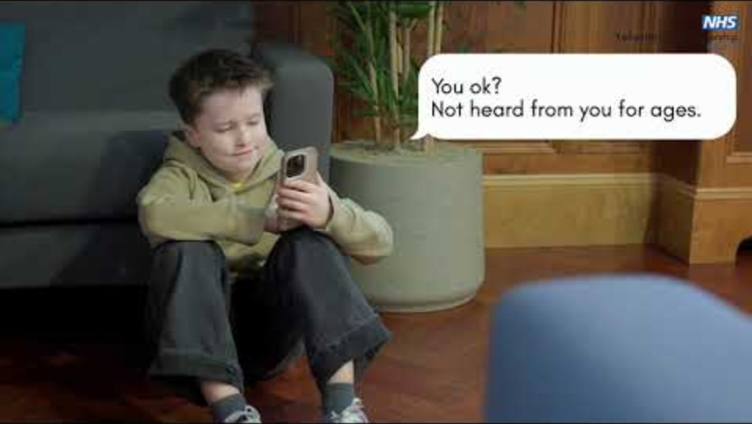

Slide 6
How can I get support from the Mental Health Support Team?
Speak to your child’s teacher and they can consider referring you to the Mental Health Support Team.
You can also be referred via your GP or alternatively, you can self-refer.

Slide 7
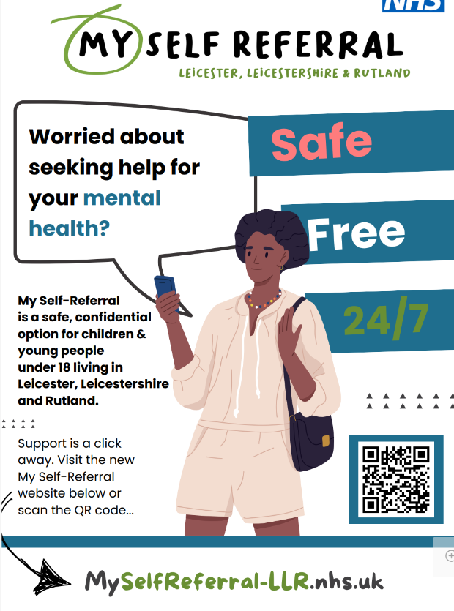

Slide 8

Questions

Slide 9
Wolsey House Primary School
Year 6
2026-2027

Slide 10
Welcome Parents!
Welcome to Year 6
  Staff who work in Year 6
  Expectations
  The Year 6 school day
  Upcoming educational trips, visits and visitors
  Secondary applications
  SATs

Slide 11
Staff who work in Year 6
Teachers
Class 9 Mrs. Bird
Class 10 Miss. Braimbridge
Class 11 Mr. Punchard
Mr. Ismail & Mrs. Coplin
Teaching Assistants
Mrs. Kilbourne
Mrs. Gangat
Mrs. Rahman

Slide 12



School Uniform
Jewellery
Stud earrings only. No necklaces or bracelets
Earrings will need to be taken out or covered with a plaster whilst doing PE
PE Kit
Your child will need to come into school dressed in their PE kit on their PE day
Indoor: Red or white t-shirt, black shorts and plimsoles
Outdoor: Jogging bottoms, zip up jacket or sweatshirt and trainers. No hoodies
Red or black jumper, cardigan or fleece. No hoodies
Grey or black trousers, skirt or pinafore dress
In the summer months a red and white gingham dress may be worn
White or Black polo shirt or white shirt or blouse
Suitable footwear must be worn. No Crocs
Indoor
Outdoor

Slide 13
Expectations:
Our Core Values
Creating a school where everyone is safe, happy and healthy and where everyone strives to live by our 6 core values:
  Responsibility.
  Respect.
  Honesty.
  Resilience.
  Aspiration.
  Cooperation.

Slide 14
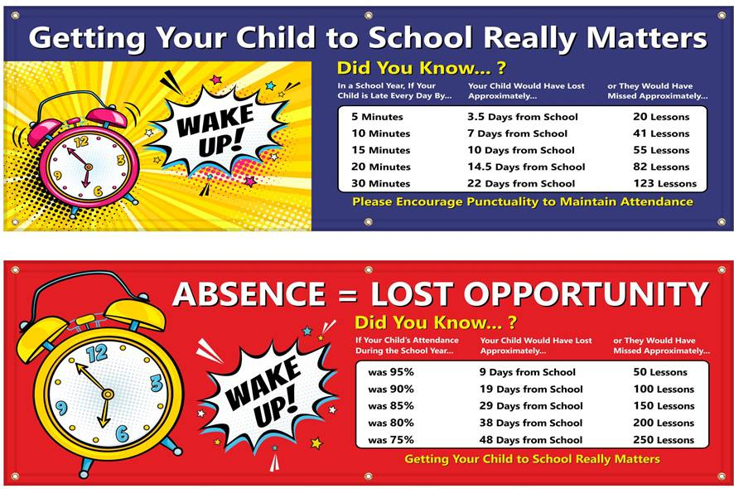
The Year 6 school day
8:40am – children line up on playground and class teacher brings them into class.
Maths and English
11:15am – break time
Reading Comprehension
12:10pm – lunch time
Curriculum Subjects and PE
3:10pm – home time

Slide 15
Upcoming educational trips, visits & Visitors.
Autumn Term
Mayan Workshops
Bikeability
Carols at the Church
Christmas Party
Families Workshop
Spring Term
Visit to a Church
Families Workshop
Summer Term
Visit to The LOPC
Visit to The Warning Zone
Swimming Lessons
Sleepover at school
End of year performance
Families Workshop

Slide 16

CGP Books – your child will have 3 CGP books: Reading, Maths and Grammar.

Slide 17




Useful Websites
TTRS – Timetables rockstars
IXL - Reading, Writing & Maths skills.
BBC – All subjects
Hit the Button – Number facts

Slide 18
Secondary Applications
Research schools - find out the catchment area that you’re in
Find schools in your catchment area
Complete the application
Submit supporting information (if required)
  Some schools, particularly faith schools, may require additional forms or evidence.

Slide 19
Why It Is Important to List More Than One School?
Key points:
Use all the preferences available to you.
Listing additional schools does not reduce your chances of getting your first-choice school.
If your first choice cannot offer a place, the council will consider your next preference, then the next, and so on.
Having several realistic choices greatly increases the likelihood of receiving an offer from a school you are happy with.

Slide 20
Wait for the offer day
  National Offer Day is usually on 1 March (or the next working day).
  You will receive one offer—the highest-ranked school on your list that can offer your child a place.
Accept the offer
  Follow your council's instructions to accept the place by the stated deadline.
If you don't get your preferred school
  You can join waiting lists and appeal decisions.
  Your child will still be offered a school place somewhere if they are eligible.

Slide 21
Support available
0116 482 0862 info@choiceadvice.org.uk
Choice Advice Service
About Us
The Choice Advice Service (CAS) Leicester is an independent service that offers free, confidential and impartial information about the admissions process, supports parents and carers to complete the application process and provides information and advice on the appeals process.
How We Can Help
We can offer you advice and information about schools and their locations. We can also give you practical support with tasks such as understanding the admissions and appeals processes and completing the online admissions application form.

Slide 22
Year 6 timeline
October 31st deadline for secondary applications
March 1st National Offer Day
May 10th - 13th SATs Week
June meetings with secondary schools
End of June beginning of July- transition days to secondary schools
Early July SATs results into school

Slide 23
SATS week 2027
Monday, May 10: Grammar, Punctuation & Spelling (GPS) Paper 1 (45 minutes) and Spelling Paper 2 (20 minutes).
Tuesday, May 11: English Reading Test (60 minutes).
Wednesday, May 12: Mathematics Paper 1: Arithmetic (30 minutes) and Mathematics Paper 2: Reasoning (40 minutes).
Thursday, May 13: Mathematics Paper 3: Reasoning (40 minutes)

Slide 24

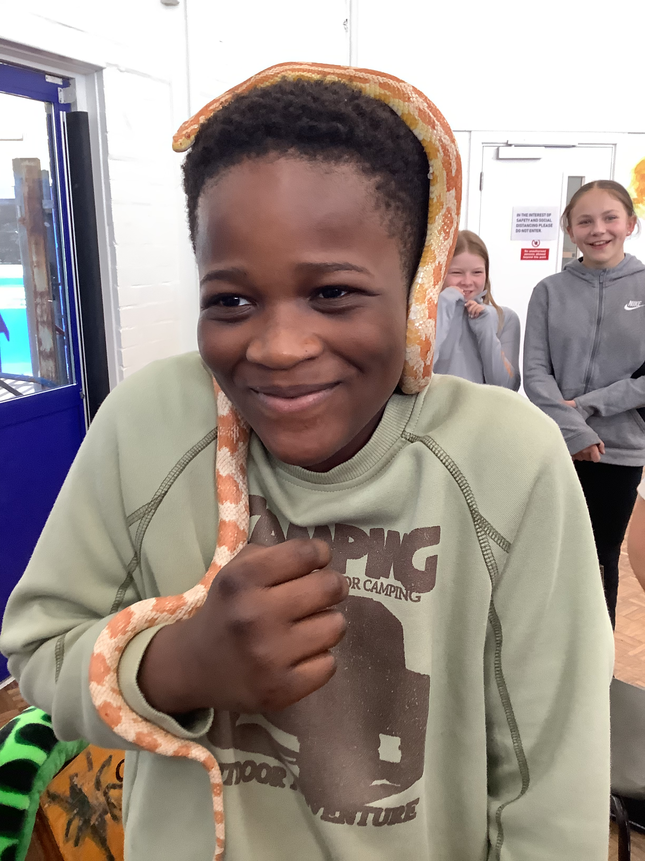
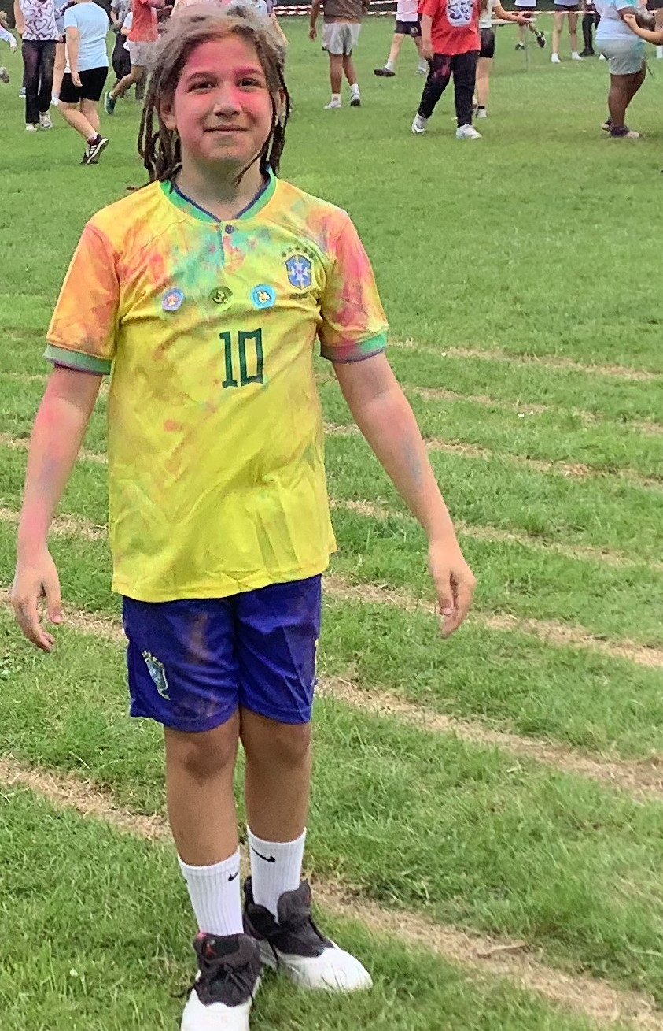
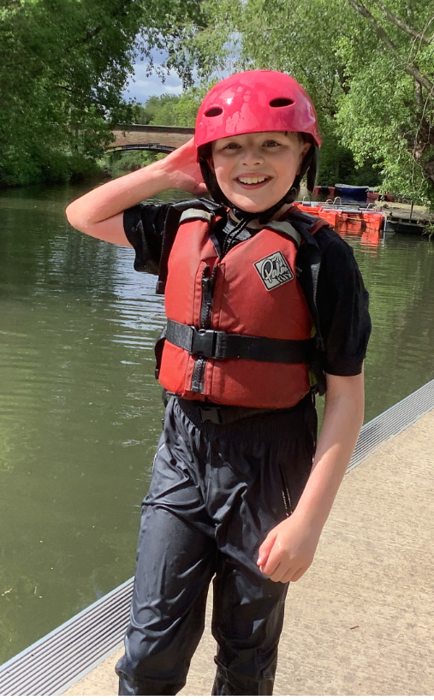
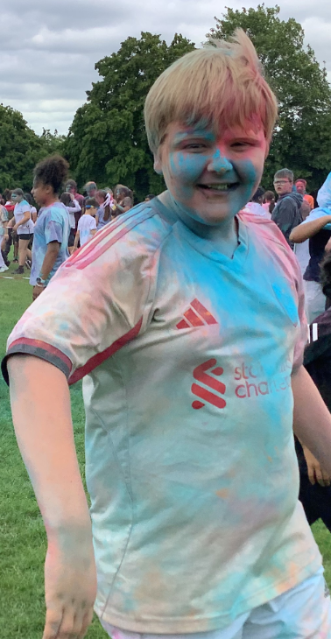

Social Media

